Slide 1

Hotel and Restaurant Reviews
ggmids
Zhenhua Wang, Kirsten Mead, Ruiqi Wang, Vivek Sahukar
Notes:
Ruiqi

Slide 2
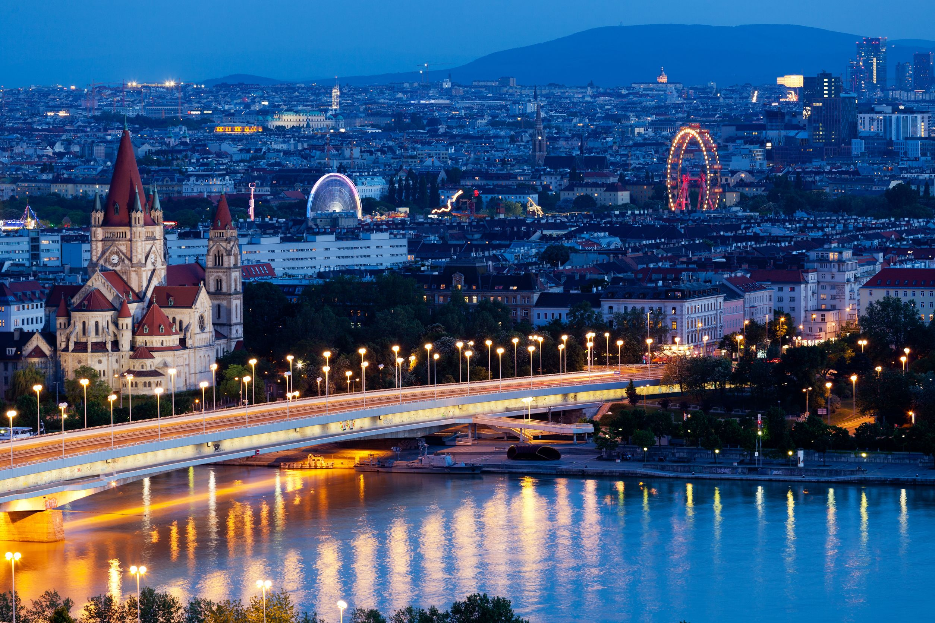
Research Questions
Notes:
Ruiqi

Slide 3

What topics matter most in reviews?
How do reviews differ by city and by reviewer nationality?
Where could the hotels improve their customer satisfaction?
How is sentiment related to tourism numbers?
Notes:
Ruiqi

Slide 4

Data
Notes:
Kirsten

Slide 5



Hotel reviews from six European cities
Restaurant reviews from 31 European cities
Average monthly temperatures
2017 tourism by city
Flights into each city

Slide 6
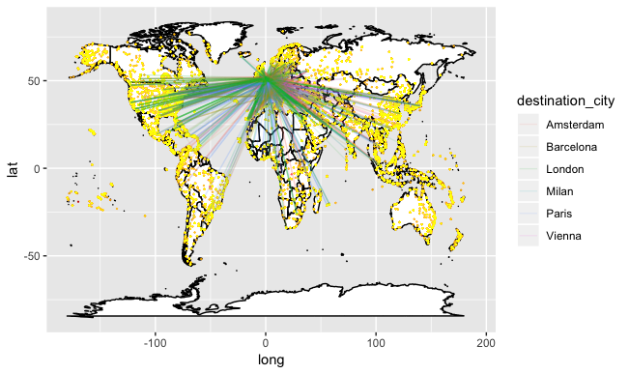

Slide 7
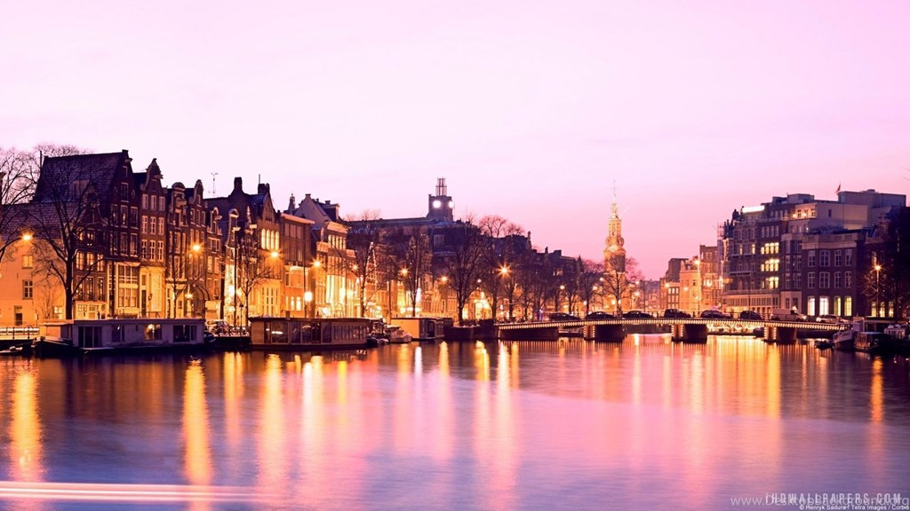
Methodology
Notes:
Kirsten

Slide 8
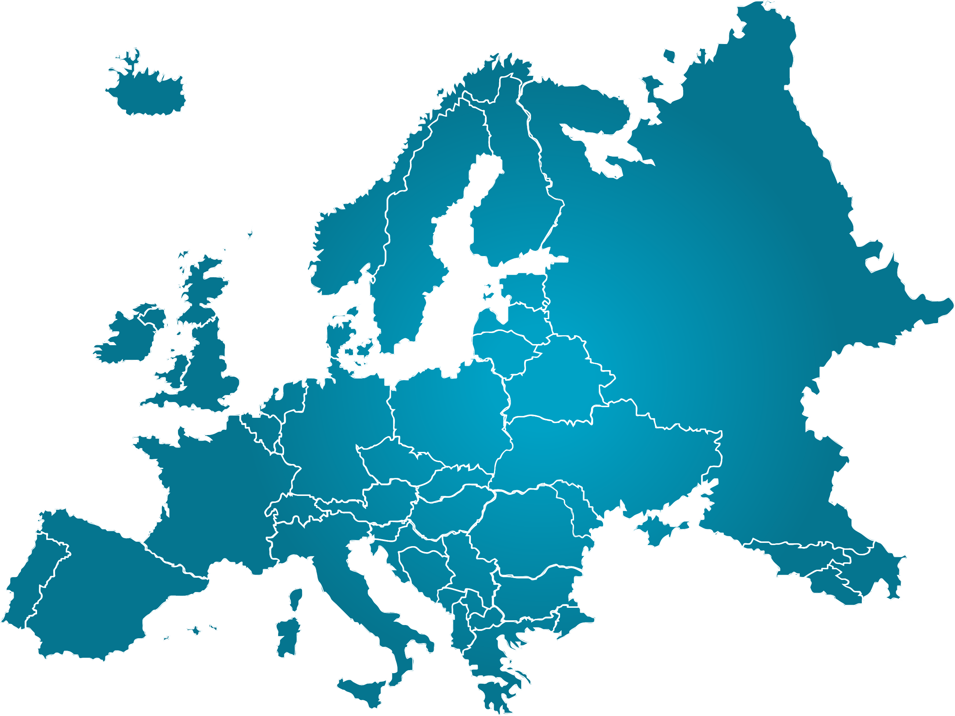
Word frequencies
Sentiment analysis
Word2Vec & CNN
Instrumental variables regression
Network analysis

Slide 9

Word Frequencies
Notes:
Kirsten/Vivek

Slide 10
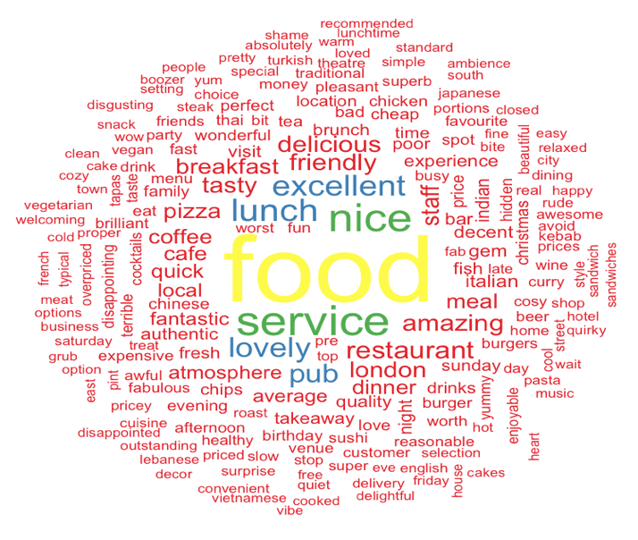
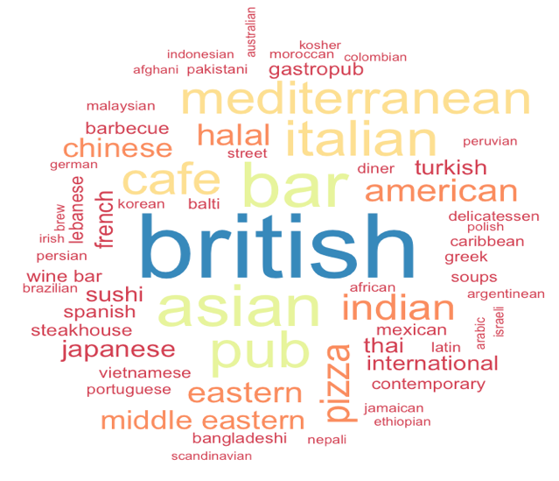
Restaurants
Notes:
Kirsten

Slide 11
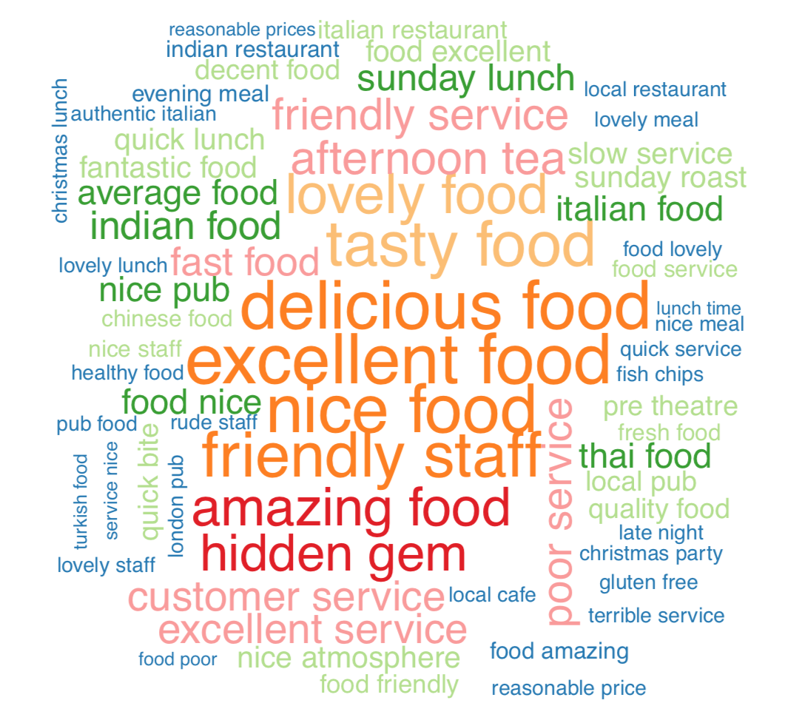
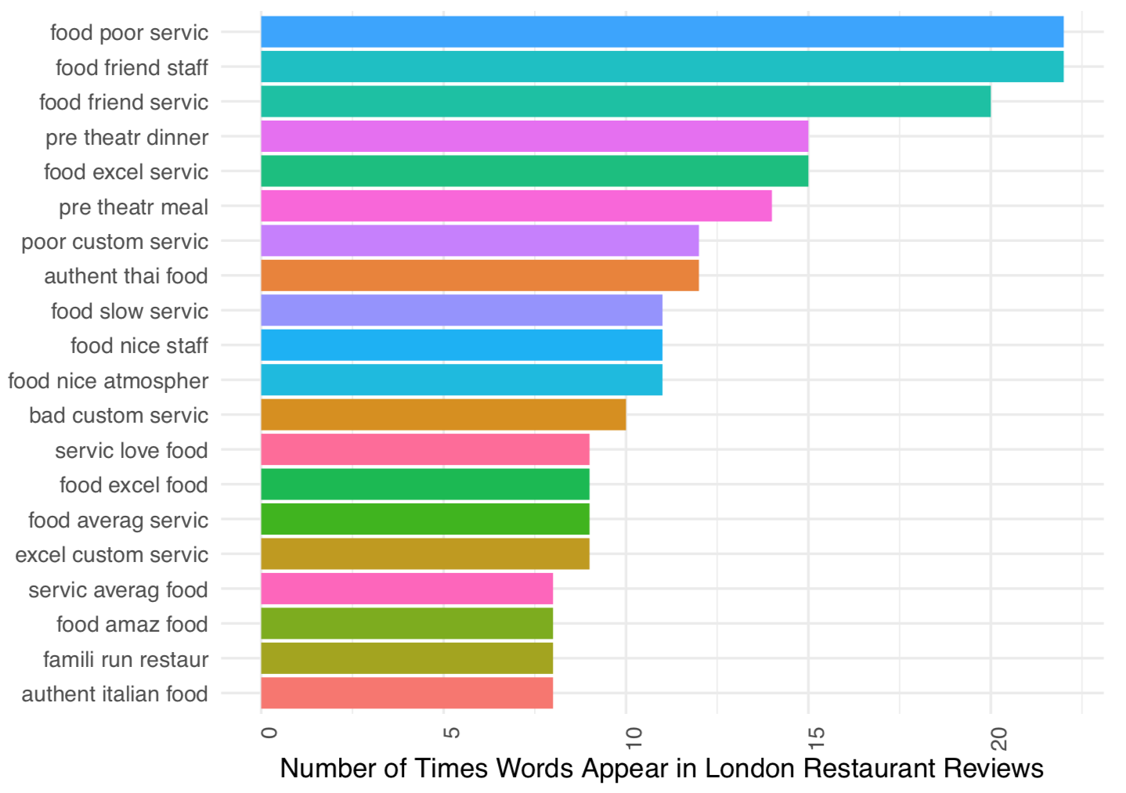
Notes:
Kirsten

Slide 12
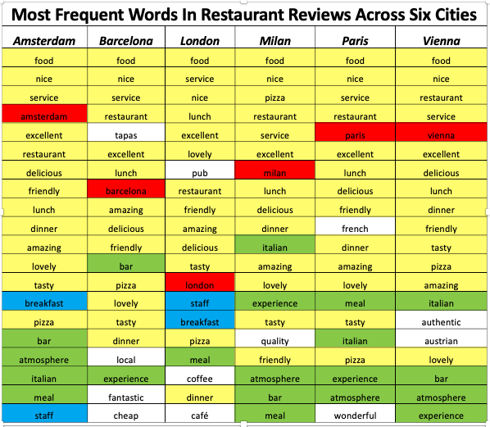

Slide 13

Common Themes
Service, atmosphere, lunch, hidden gem
Restaurant type: bars, Italian, Asian, café, pubs
Adjectives: excellent, nice, friendly, lovely, delicious, tasty

Slide 14

Unique observations
Most popular cuisine
Amount of cuisine variety
Barcelona: tapas, poor service
London: Afternoon tea, Sunday lunch/roast, pre-theatre, Christmas party/lunch
Milan: most reasonably priced, business lunch
Paris: more focus on food than service, people watching

Slide 15
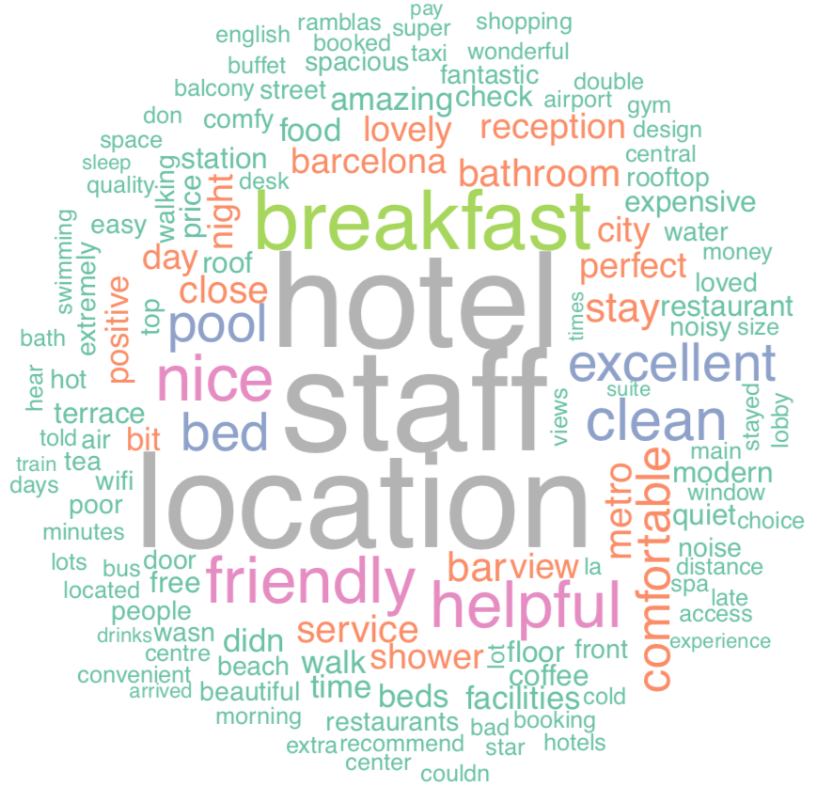
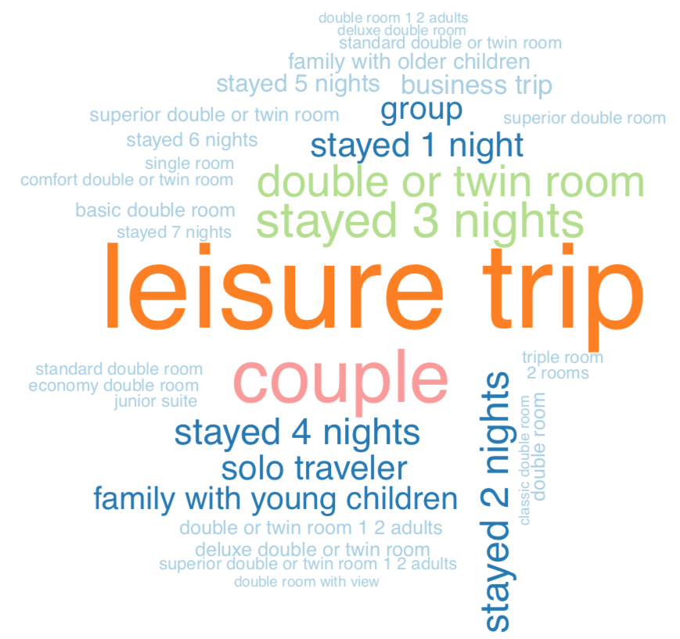
Hotels
Notes:
Kirsten

Slide 16
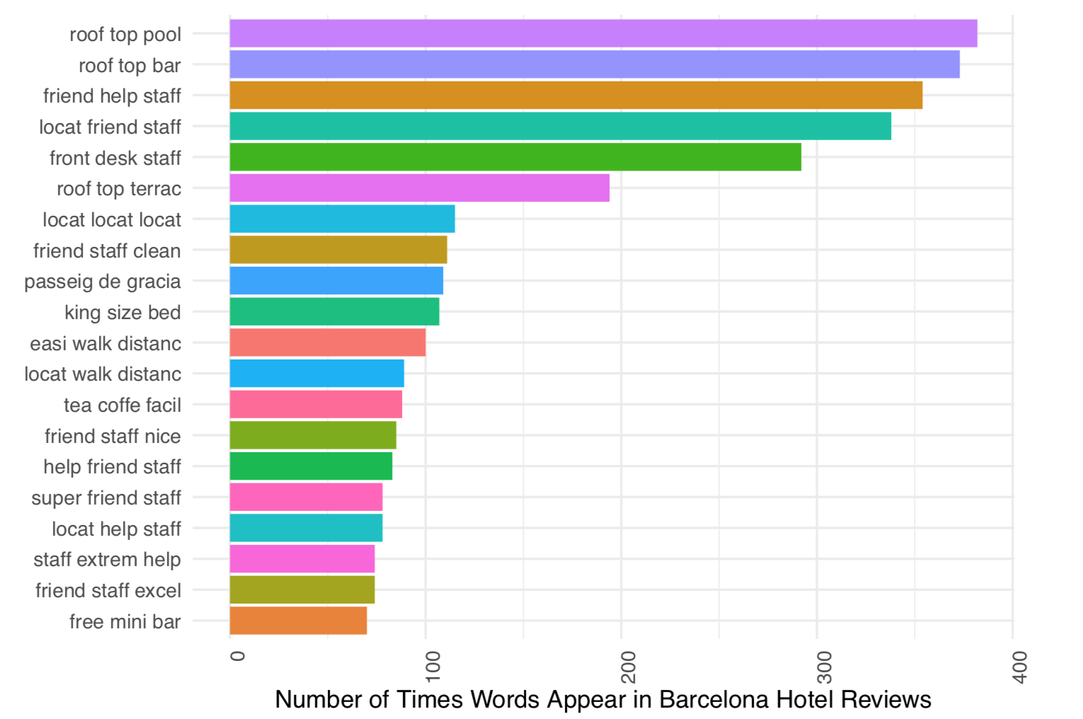
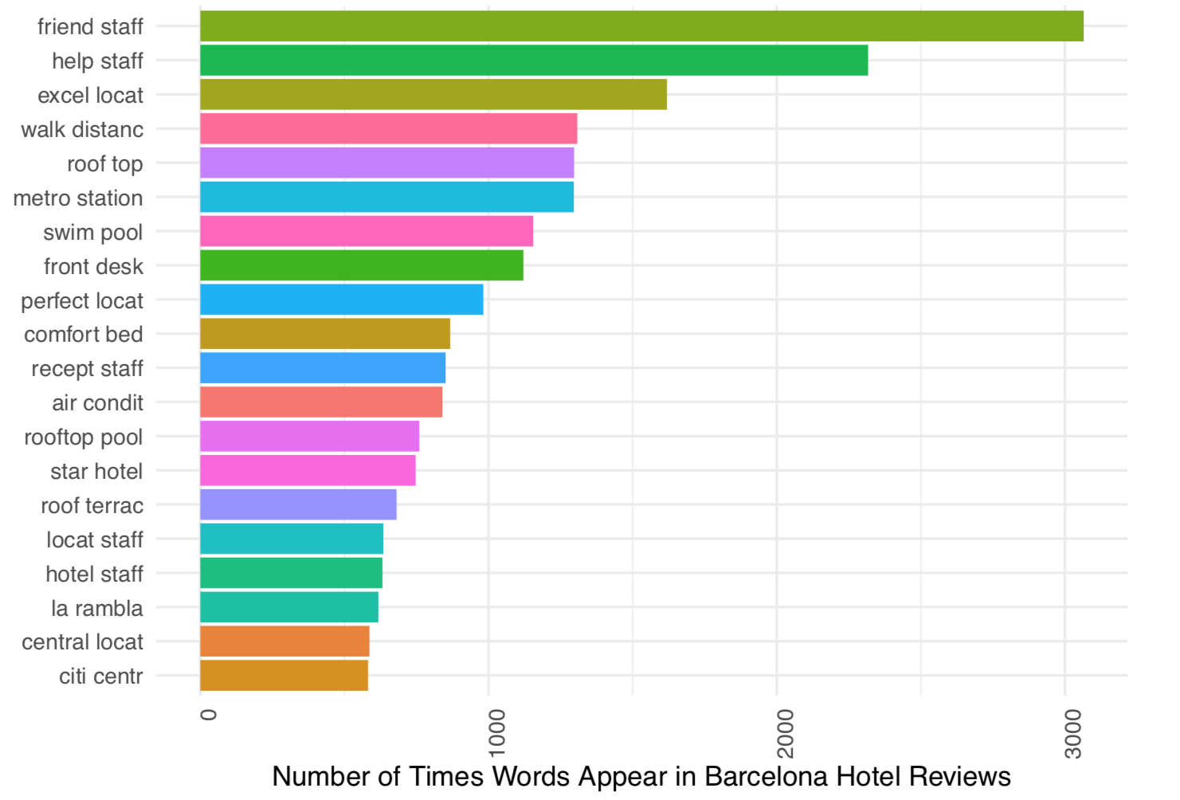
Notes:
Kirsten

Slide 17

Common themes
Location, staff, room, view, noise, transportation, breakfast, wifi, mini bar
Adjectives: friendly, helpful, comfortable, clean, excellent
Tags: leisure trips, couples, stayed 2 nights

Slide 18
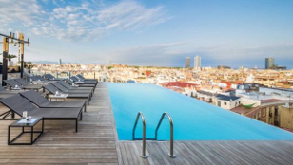
Unique observations
City-specific landmarks
Barcelona: rooftop pools and terraces, longer stays, fewer business trips
Paris: boutique hotels
London: shorter stays
Amsterdam: fewer families

Slide 19
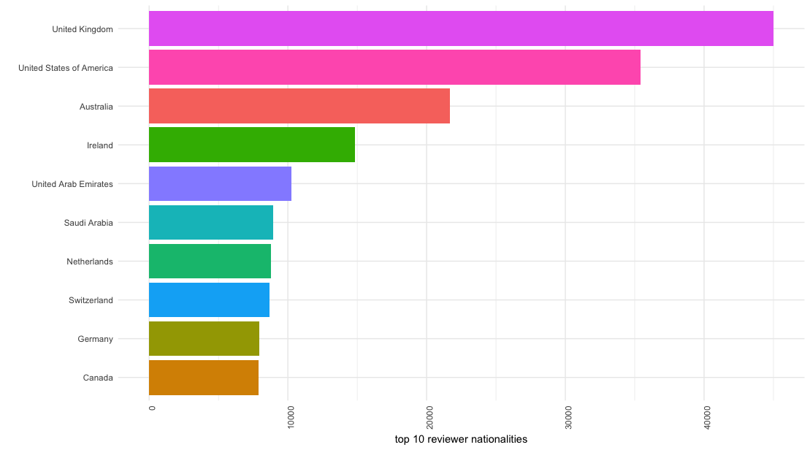
Most common nationalities of the reviewers:

Slide 20
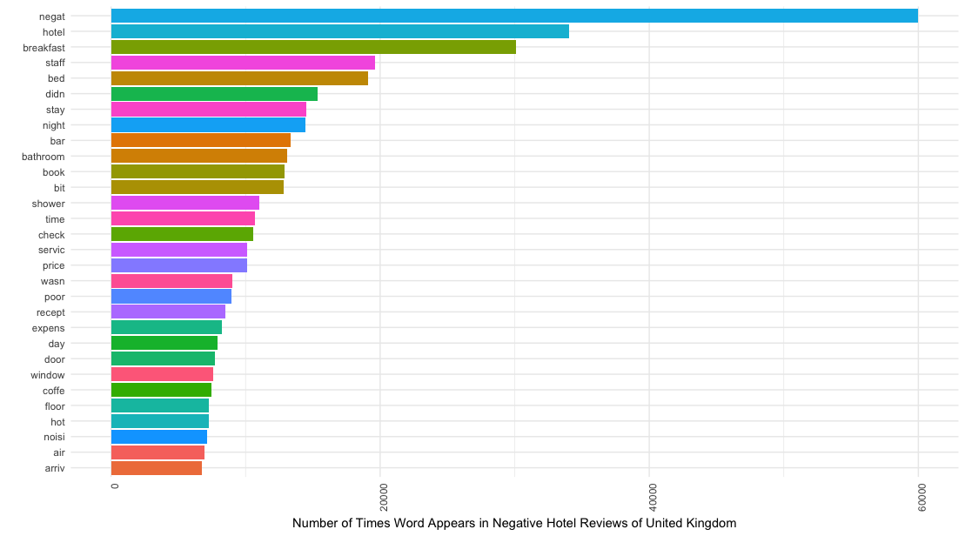
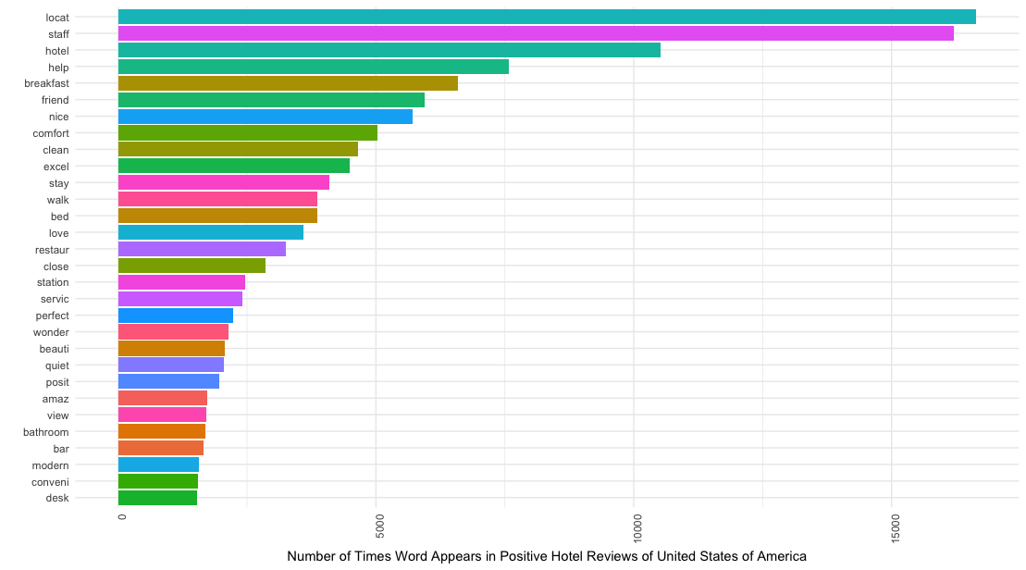
Most mentioned words for hotels by reviewer nationalities
Common Themes: locations, staff, service, bed, breakfast,etc.

Slide 21
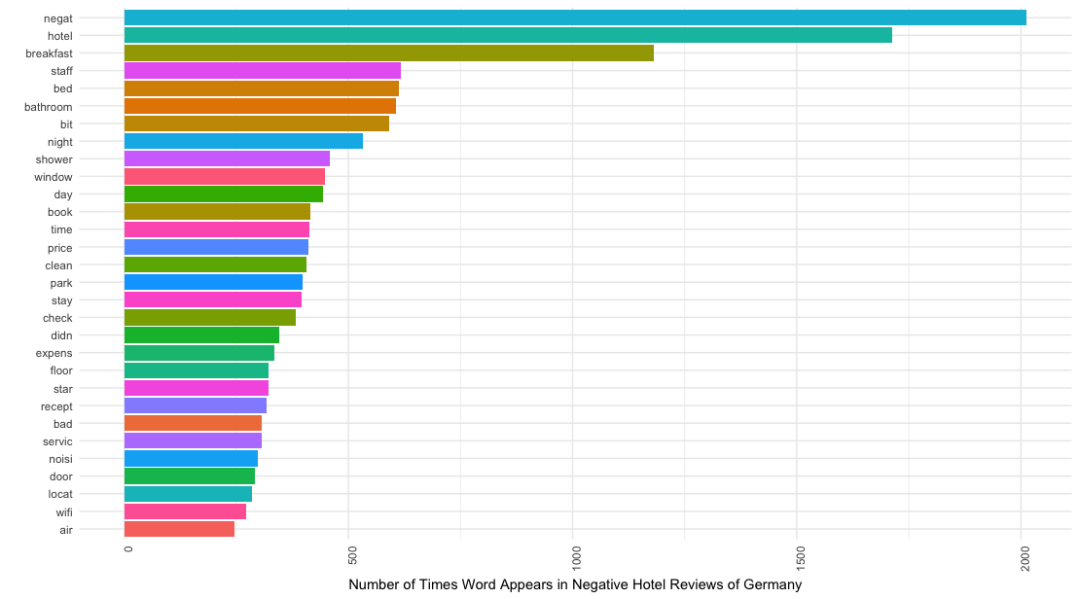
Unique Observations
United Kingdom
location, quietness, coffee, tea, and bars, wifi
United States and Australia
wifi, elevator, restaurant
Ireland and Saudi Arabia
prices
Netherland
cleanness
Germany
bathroom, shower, windows, views

Slide 22
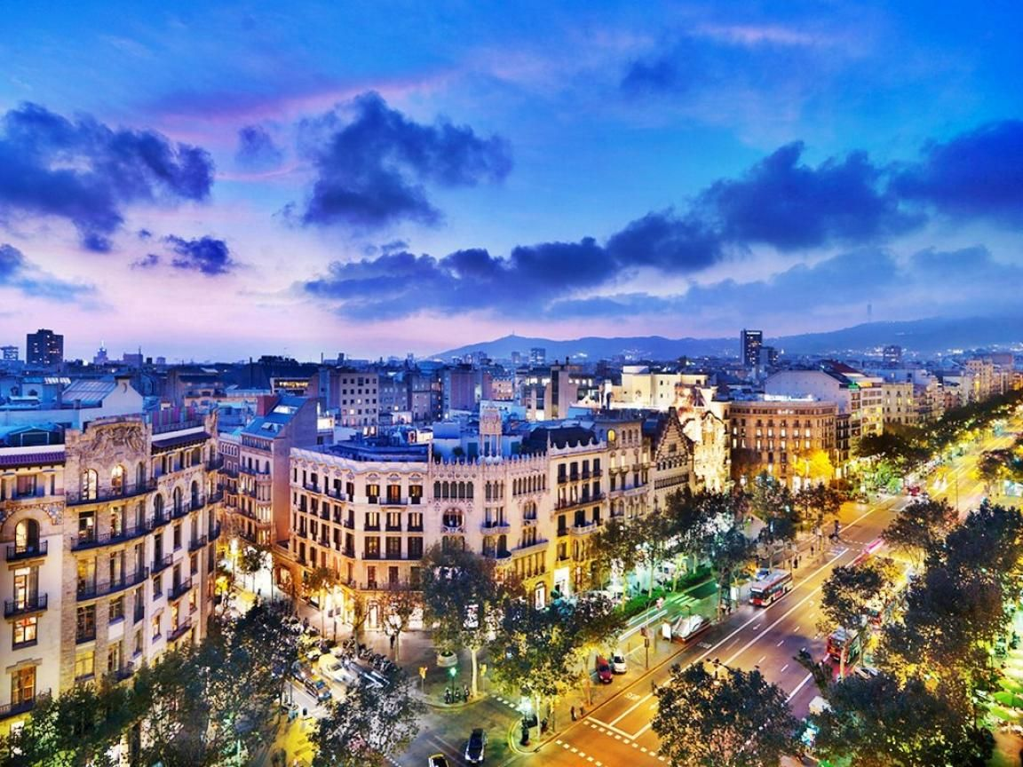
Sentiment Analysis
Notes:
Ruiqi/Zhenhua/Vivek

Slide 23
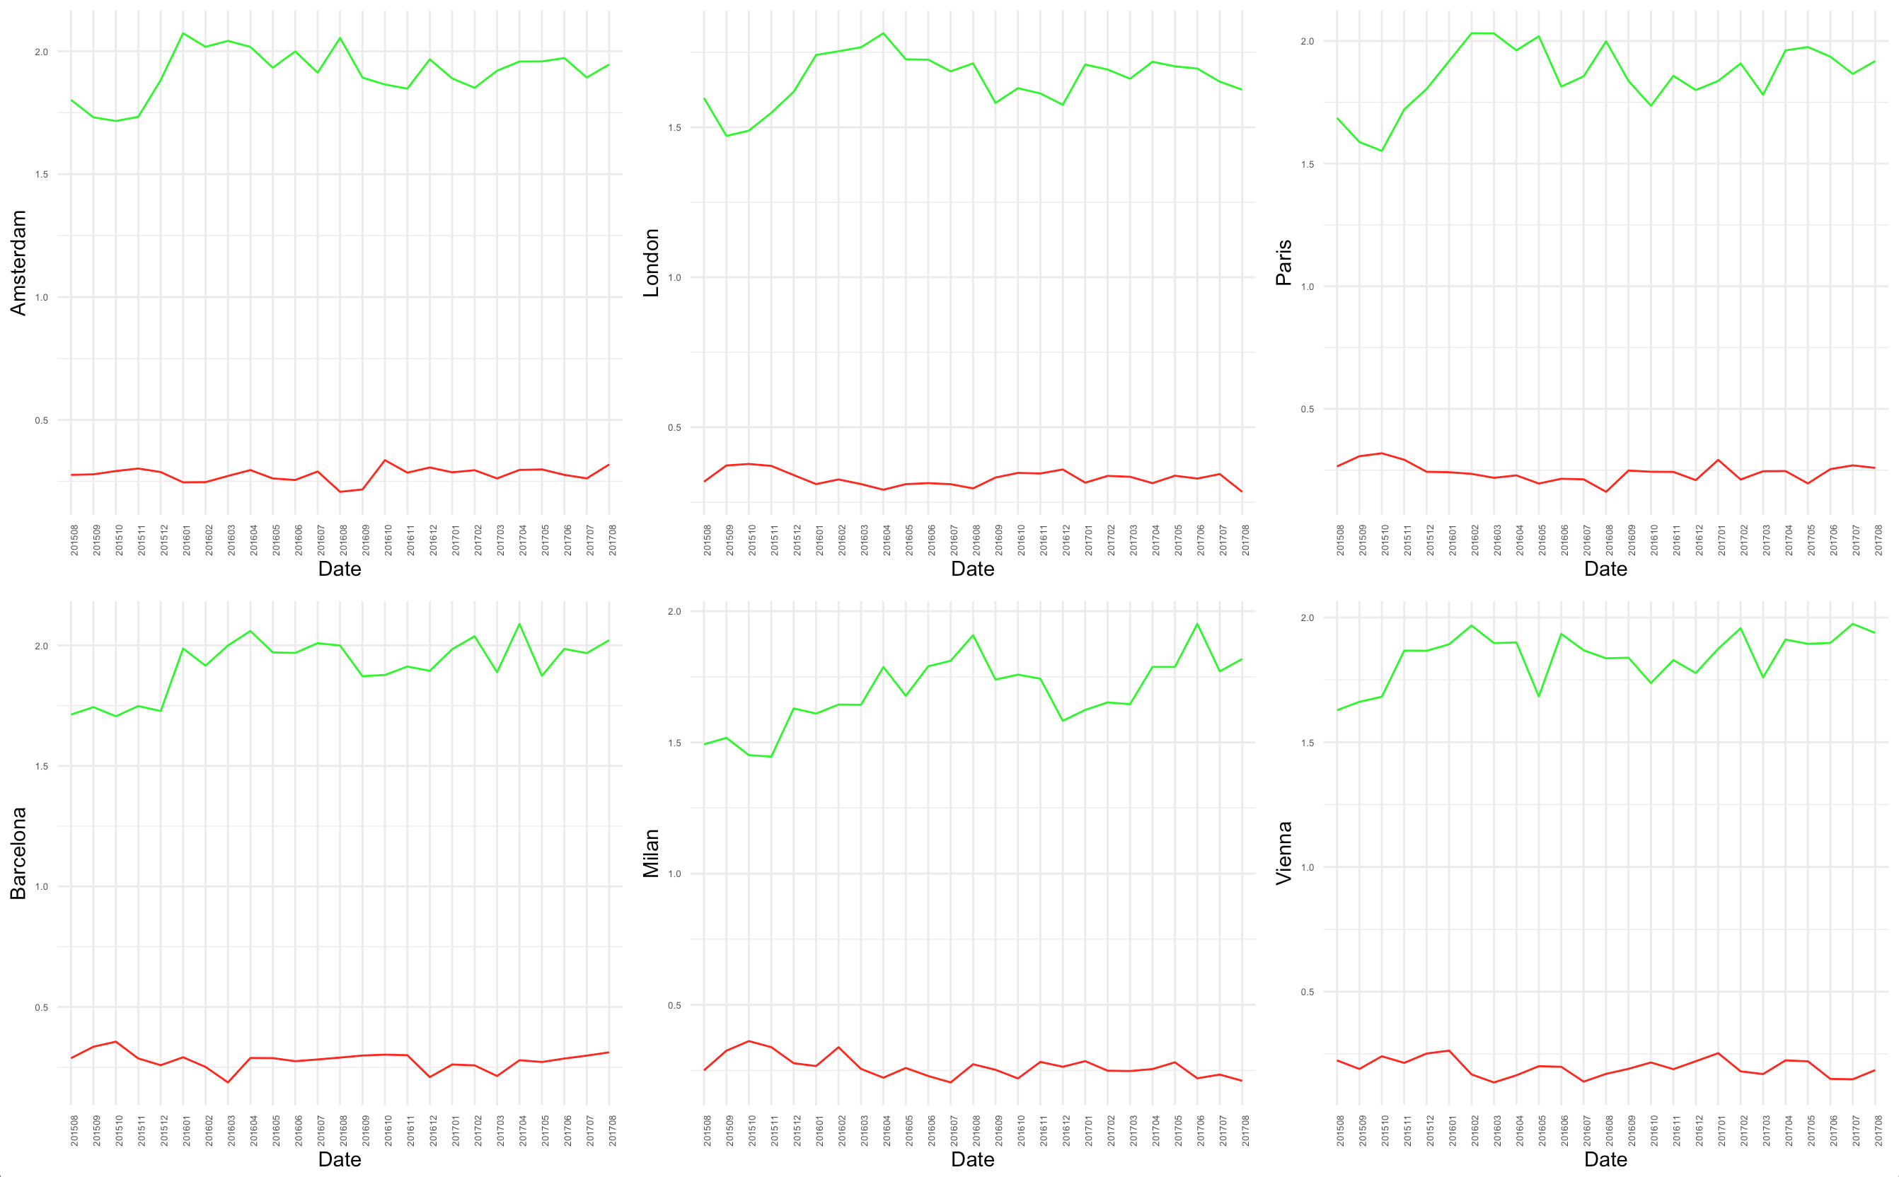
Hotel sentiments
Trends
Number of positive sentiments improved
Number of negative sentiments remained stable
As a result, hotels slightly improved over 2 years
Positive Bias

Slide 24
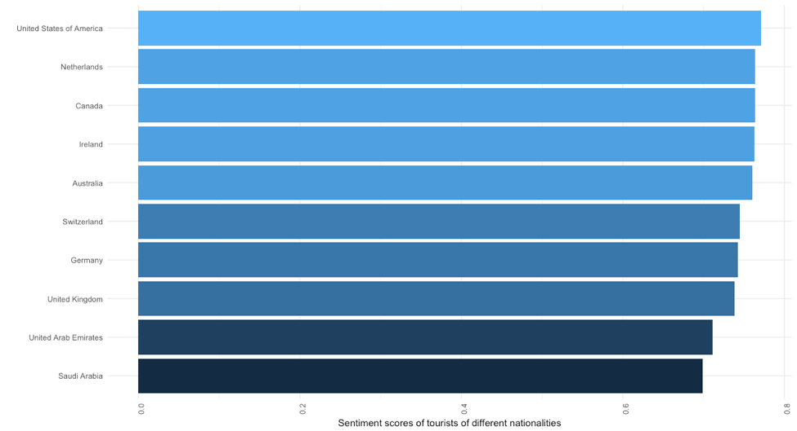
Sentiment scores by reviewer nationality

Slide 25
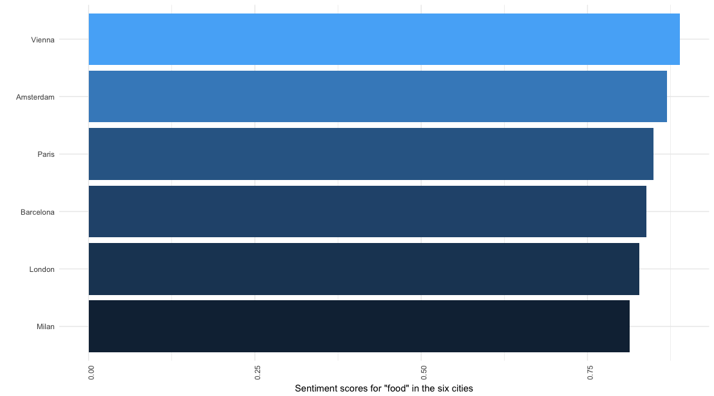
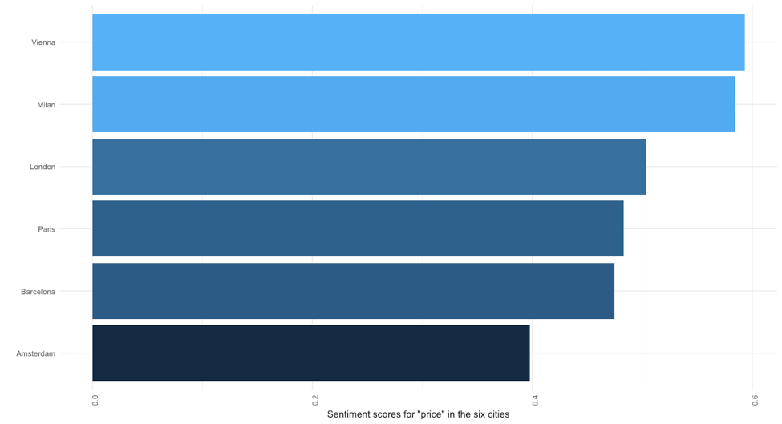
Sentiment scores for hotel features
Vienna: best staff, prices, breakfast, food, bathrooms
Barcelona: best bars, showers
Paris: most comfortable beds, most satisfying restaurants
London: best locations

Slide 26
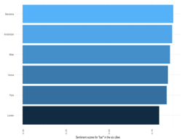
Ovservations

Slide 27
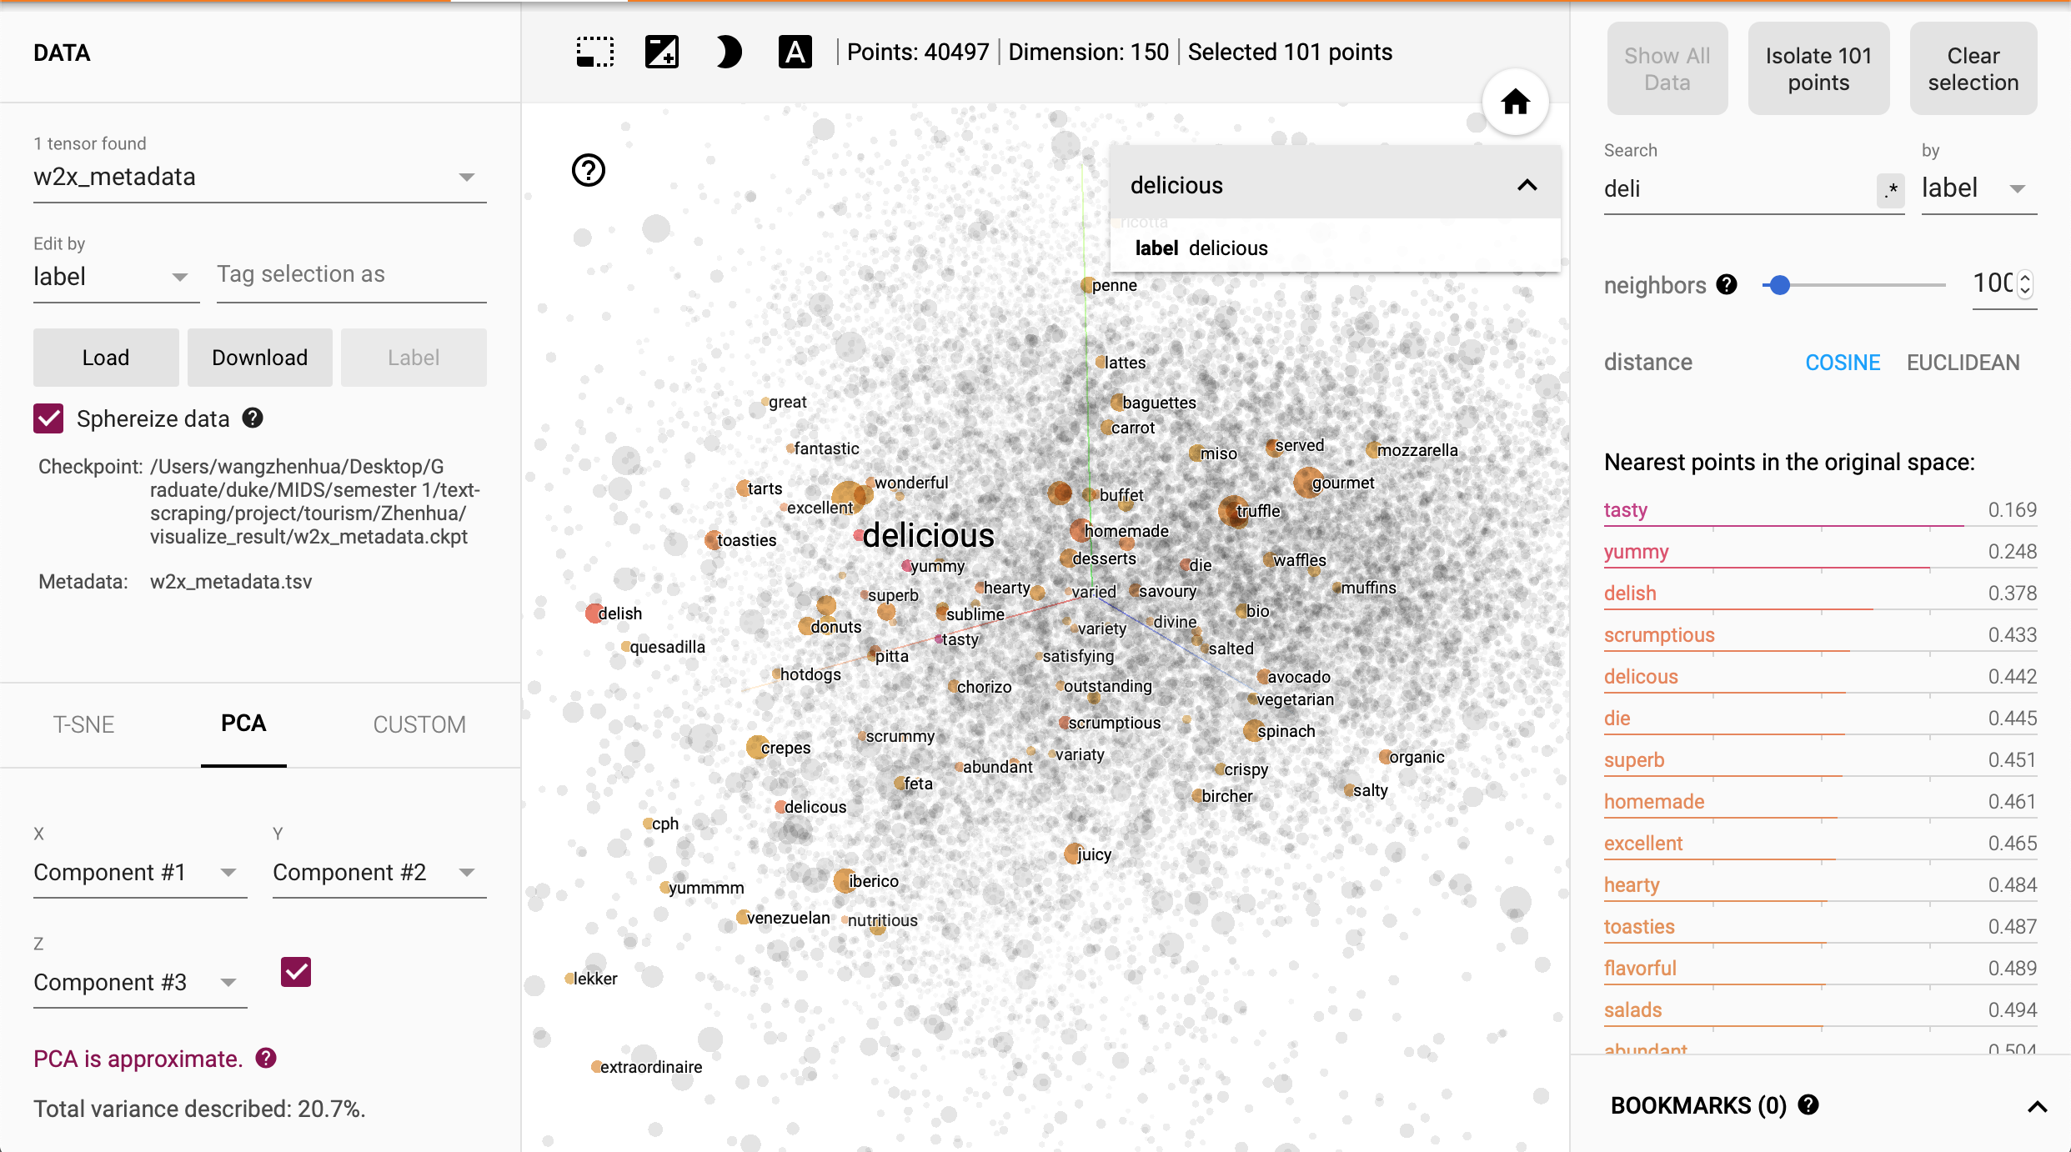
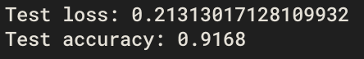
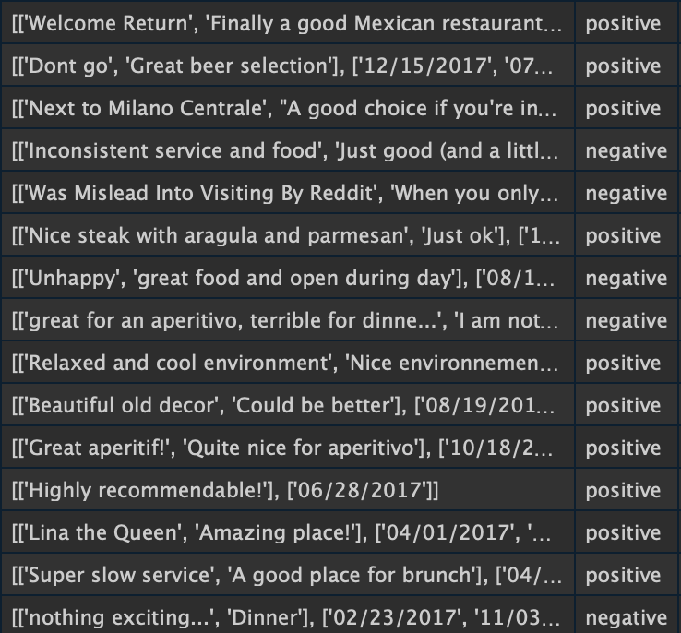
Sentiment classifier for restaurant reviews
1. WORD2VEC
2. CNN sentiment classifier
a. Test error on hotel reviews
b. classification on restaurant reviews

Slide 28
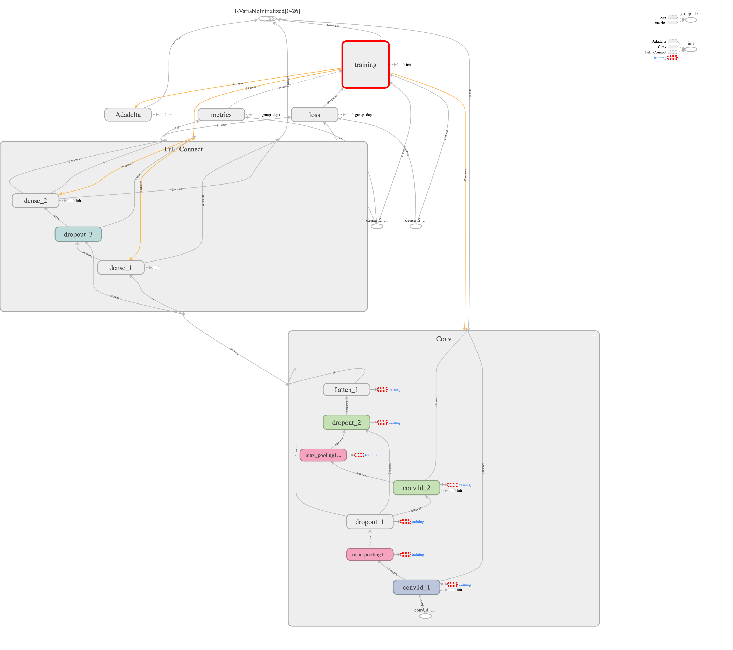
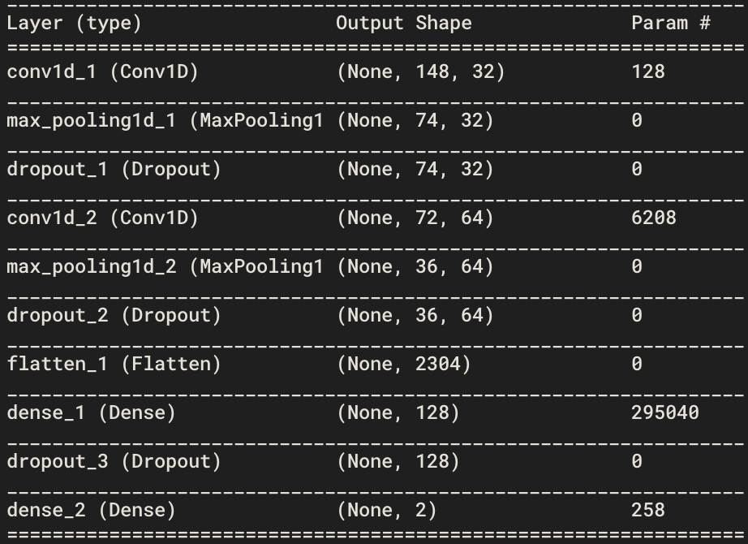
Model

Slide 29
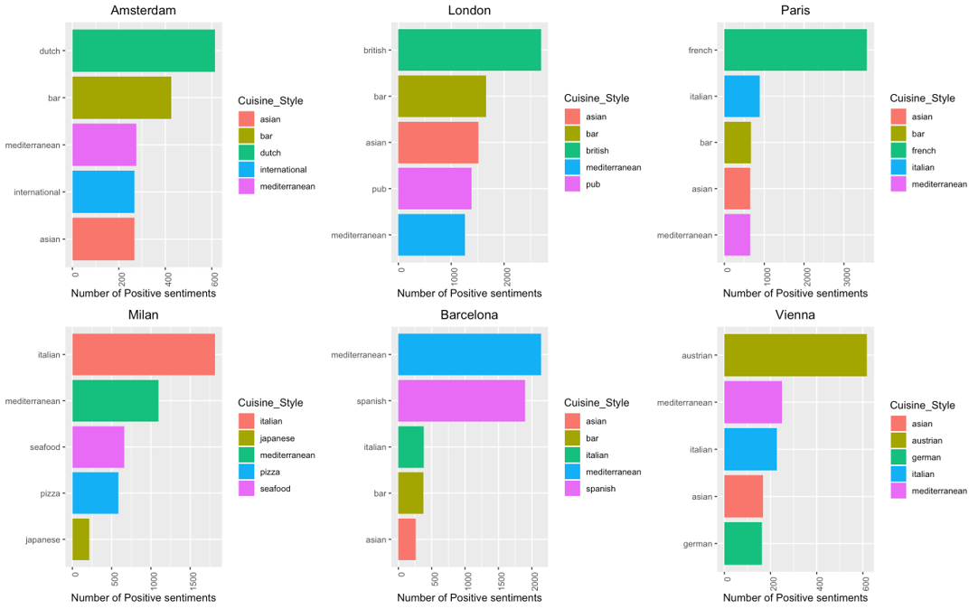
Top 5 popular cuisine style based on sentiments

Slide 30
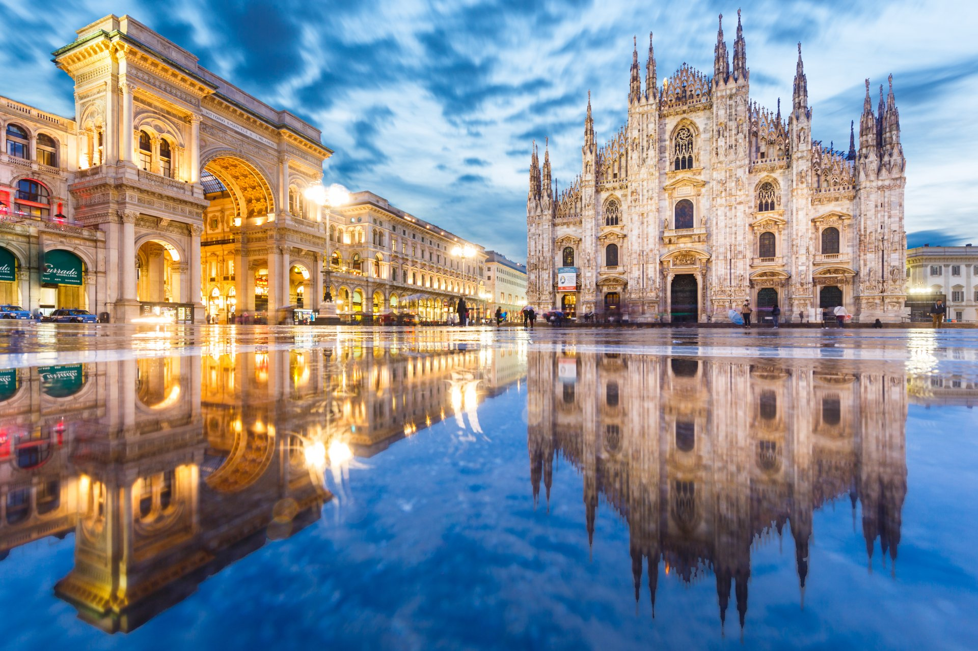
Instrumental Variables Regression
Notes:
Kirsten

Slide 31

Grouped by month and city
Dependent variable: review count
Independent variable: sentiment
Instrument: average temperature

Slide 32
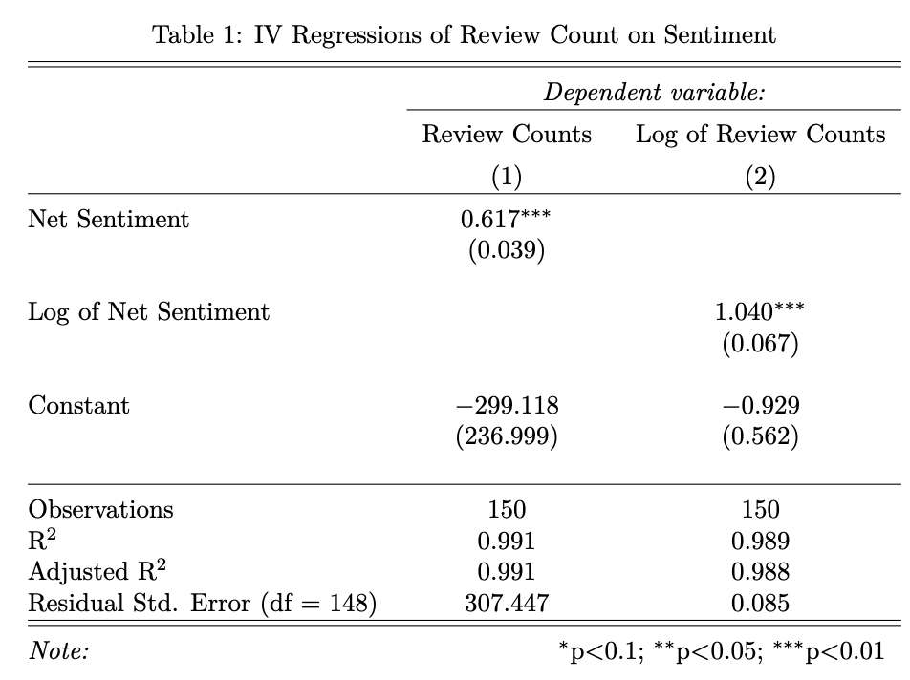

Slide 33
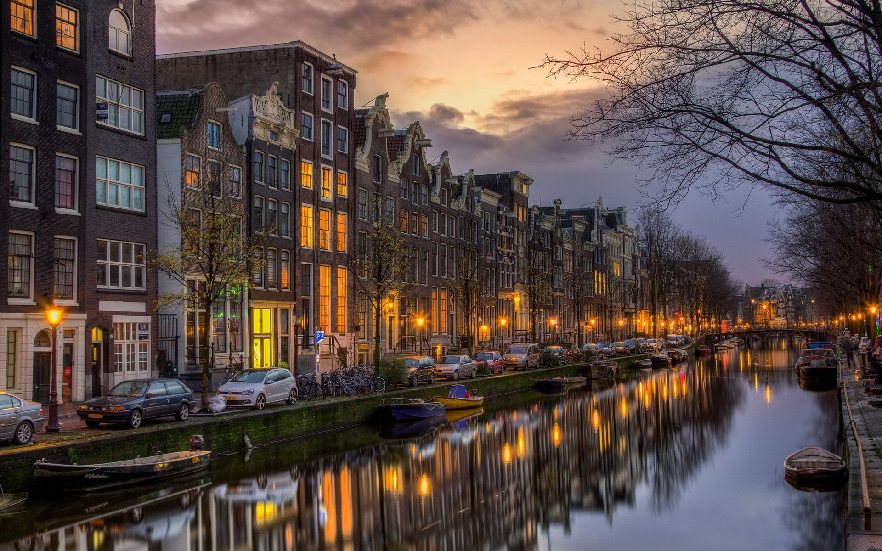
Network Analysis
Notes:
Vivek

Slide 34
Network analysis : Methodology
More precise than "bag of words" approach.
Topic models not used because the reviews for each observation are short texts.
Both the restaurant and hotel datasets were filtered for the earlier mentioned 6 cities of interest.
The network was made out of restaurant reviews with nodes as "cities" and edges based on overlap in "words" (nouns or noun phrases only) between the nodes .
Since the hotel dataset is too large to process at once for network analysis, it was filtered in 6 different datasets based on cities.
Hotels network
Nodes: Top ten nations (to which the reviewers belong to)
Edges: Words common between the reviewers of different nationalities
Tuning parameter alpha set to 0.35

Slide 35
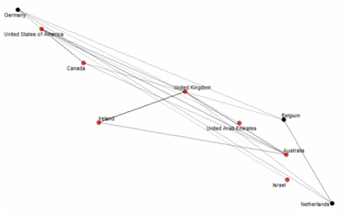
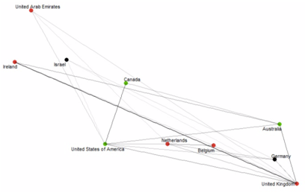
Network Analysis - Amsterdam hotel reviews
Positive Reviews
Negative Reviews
C
UK is the only node with betweenness centrality of 1.
Reviewer Sentiment | Reviewer Nationality | Common themes
Positive | Belgium, Germany, Netherlands | cereal, parking, shower, jazz, staff
Positive | Australia, Canada, Ireland, Israel, UAE, UK, USA | city, washroom, breakfast, espresso, service, location, taxi, staff, room close
Negative | All above countries – all nodes belong to same group | powerpoint, veranda, patio, pickup, washroom, center, vacation
Notes:
People who are outside amsterdam – they are on business trip too, value more servcie, proximity to station or transport
European people – it's more about service, music.

Slide 36
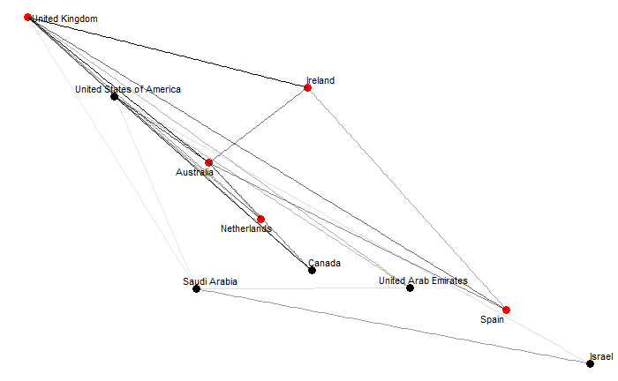
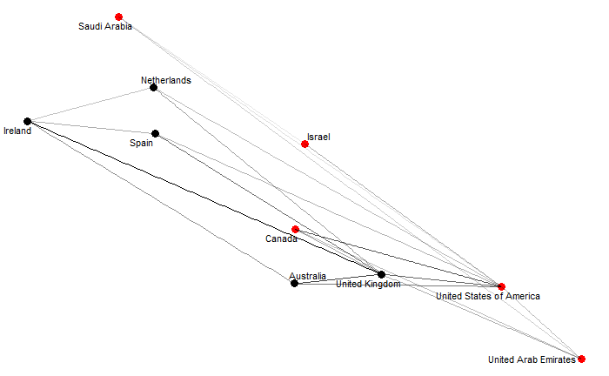
Network analysis : Barcelona hotel reviews
Positive Reviews
Negative Reviews
C
No groups with different modularity class in both positive and negative reviews UK is the only node with non-zero betweenness centrality (3)
Reviewer Sentiment | Reviewer Nationality | Common themes
Positive | Australia, Canada, Ireland, Israel, Netherlands, Saudi Arabia, Spain, UAE, UK, USA | Position, breakfast, style, location, night club, variety
Negative | Same as above | Bedbug, dryer, air charger, privacy, credit card, temperature
Notes:
People face problems with privacy and payment here (also with bed bugs so that's why may be night life more vibrant!).
Nighlife a big plus in Barcelona (did some google search on travel forums)

Slide 37
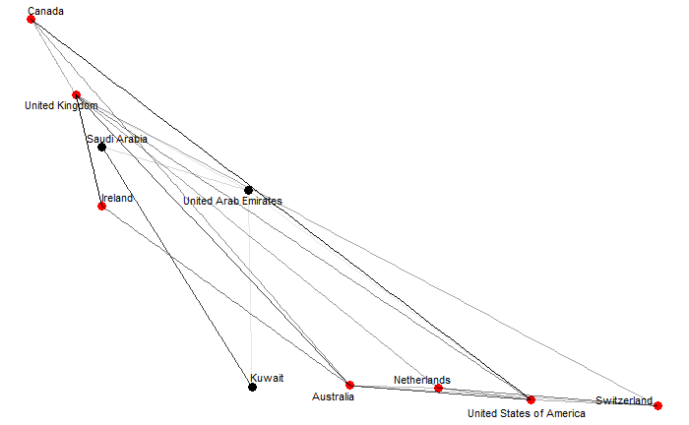
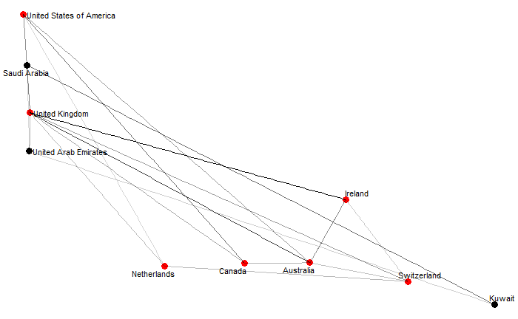
Network analysis : London hotel reviews
Positive Reviews
Negative Reviews
C
All nodes have betweenness centrality of zero, except UK (in positive reviews) and Saudi Arabia (in negative reviews)
Reviewer Sentiment | Reviewer Nationality | Common themes
Positive | Australia, Canada, Ireland, Netherlands, Switzerland, UK, USA | Eurostar, pub, bar staff, underground station, personnel, café royal
Positive | Kuwait, Saudi Arabia, UAE | Chick, oxford street, desk staff, fatma, floor heater, location, staff knowledge, staff cleanliness
Negative | Australia, Canada, Ireland, Netherlands, Switzerland, UK, USA | Bar fridge, face washer, washroom, room service, comforter, washcloth
Negative | Kuwa, Saudi Arabia, UAE | Baby buggy, cleanliness, desk lady, guarantee, fax, hotel internet, management, money, security man, servcie, room dine
Notes:
No drink or pub for reviewers from Middle East

Slide 38
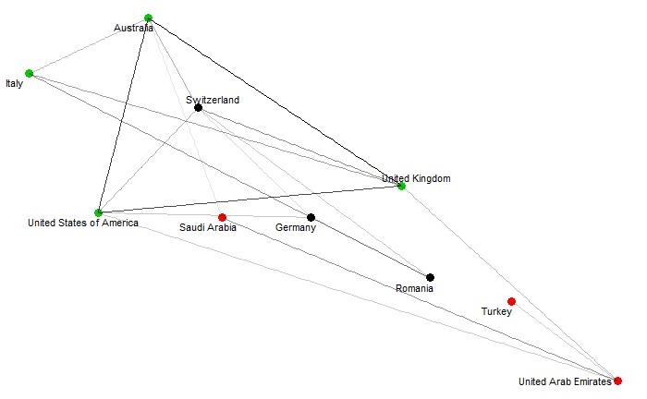
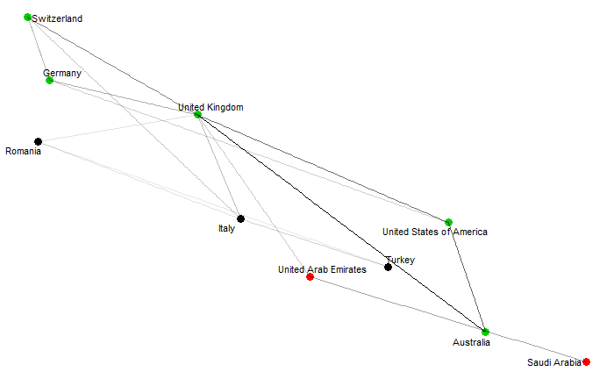
Network analysis : Milan hotel reviews
Positive Reviews
Negative Reviews
C
Only Australia is the node with betweenness centrality (1) in negative reviews.
Reviewer Sentiment | Reviewer Nationality | Common themes
Positive | Saudi Arabia, UAE | Breakfast, location manager, people, treatment, hilton, structure
Positive | Australia, Germany, Italy, Romania, Switzerland, Turkey, UAE, UK, USA | Camera, position, hydromassage, sheet, autopark, park view room, personnel, shopping facility
Negative | All above, no nodes with diferent modularity class | Luggage, steam sauna, book price, car park, coffee, towel, shampoo, tissue, water bottle, bellhop
Notes:
People from middle east focused on treatment, service.
Milan is fashion hub, so other reviewers focus on shopping, aesthetics

Slide 39
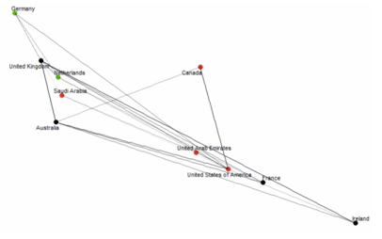
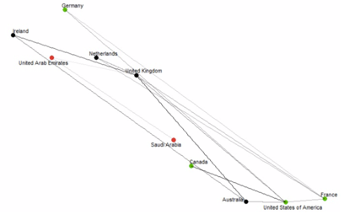
Network analysis : Paris hotel reviews
Positive Reviews
Negative Reviews
C
All nodes with same modularity class of 1; Again UK is the only node with non-zero betweenness centrality (1) in positive reviews.
Reviewer Sentiment | Reviewer Nationality | Common themes
Positive | Australia, Canada, France, Germany, Ireland, Netherlands, Saudi Arabia, UAE, UK, USA | Position, range, airco, staff, location, credit card, service
Negative | Same as above | Western, ice gel, décor, airco, bathtub, credit card, view
Notes:
Credit card services seems to be deal maker or breaker for the reviewers.

Slide 40
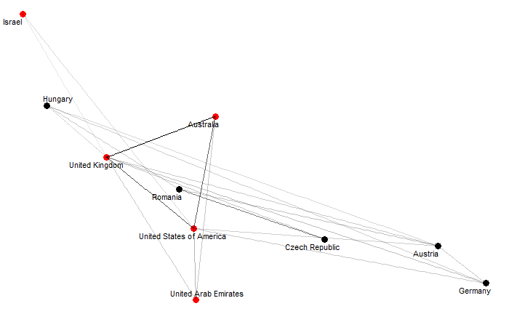
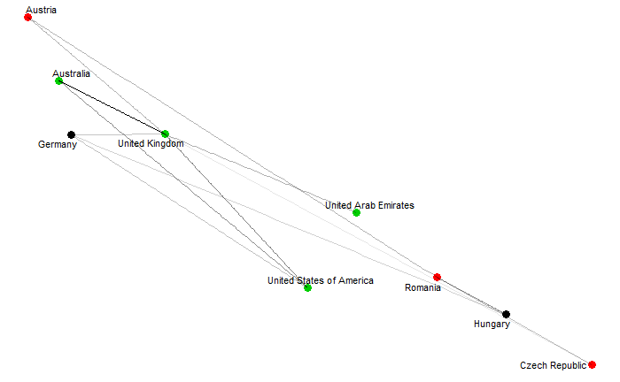
Network analysis : Vienna hotel reviews
Positive Reviews
Negative Reviews
C
All nodes have zero betweenness centrality
Reviewer Sentiment | Reviewer Nationality | Common themes
Positive | Austria, Czech Republic, Germany Hungary, Israel, Romania | View, atmosphere, metro, wien, hotel sacher, sch nburnn, parking, position, vienna
Positive | Australia, UAE, UK, USA | Breakfast, facility, location, reception, river side, vintage, bedroom, transport link
Negative | All the above | Premise, thief, bike, parking, blanket, room, hostess
Notes:
Vienna has 2 types of reviewers : non- European and European
European reviewers use their own language while writing reviews.
Theft is the strong negative word that has come up here only across all 6 cities.

Slide 41
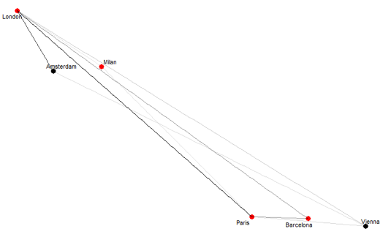
Network analysis : Restaurant reviews
All nodes with betweenness centrality or closeness centrality as zero; Network very sparse
Common themes across all restaurants in 6 cities | Nothing as such

Slide 42
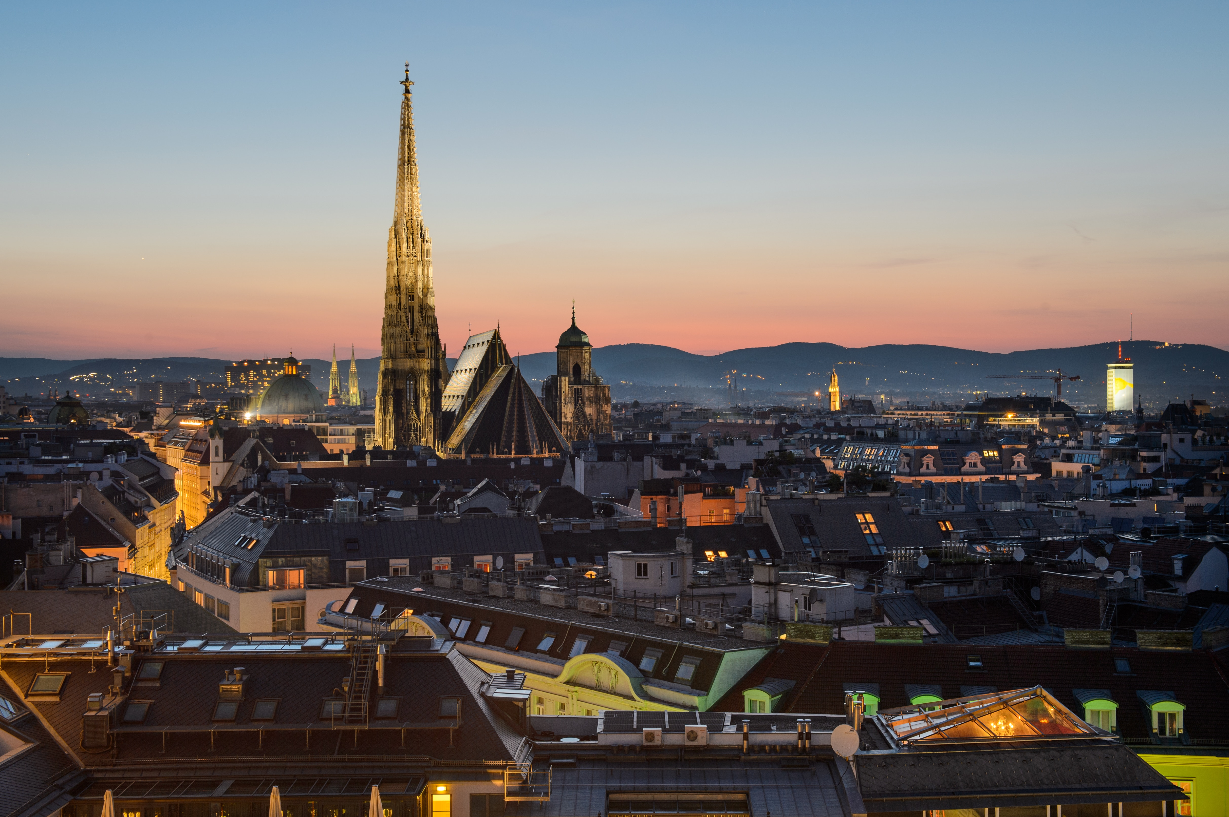
Limitations
Notes:
Ruiqi

Slide 43
Hard to find out "sarcasm" or complex sentiments (mixture of different types of words in sentence.
e.g. This sentiment was classified as 'positive' in hotel reviews dataset "Only the park view was great". Here this sentiment hints that the reviewer is trying to say that nothing in the hotel was good.
The hotels dataset was too large to do network analysis on the entire dataset at once.
Few cities in the hotels dataset
Difficult to get subtle themes from network analysis. Also if the network is too dense or sparse, then not sure whether any relevant information can be extracted.

Slide 44
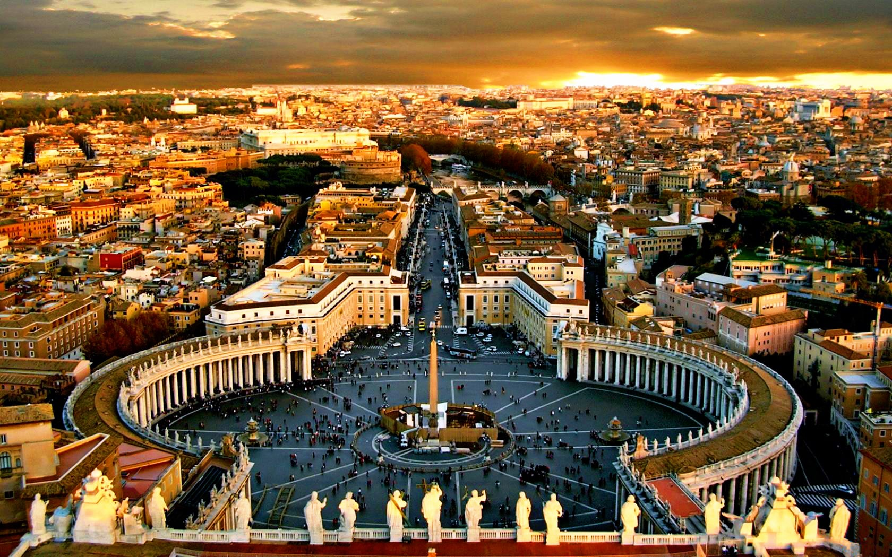
Thank You

Slide 45
References
https://www.kaggle.com/jiashenliu/515k-hotel-reviews-data-in-europe
https://www.kaggle.com/damienbeneschi/krakow-ta-restaurans-data-raw
https://www.worldweatheronline.com/
https://www.statista.com/statistics/314340/leading-european-city-tourism-destinations-by-number-of-bednights/
https://github.com/cbail/textnets
https://www.tidytextmining.com
Hlavac, Marek (2018). stargazer: Well-Formatted Regression and Summary Statistics Tables. R package version 5.2.2. https://CRAN.R-project.org/package=stargazer
Dos Santos C, Gatti M. Deep convolutional neural networks for sentiment analysis of short texts[C]//Proceedings of COLING 2014, the 25th International Conference on Computational Linguistics: Technical Papers. 2014: 69-78.

